Slide 1
C343 C++ Snakes and Ladders
Paul van Sittert
Aadil Sohail

Slide 2
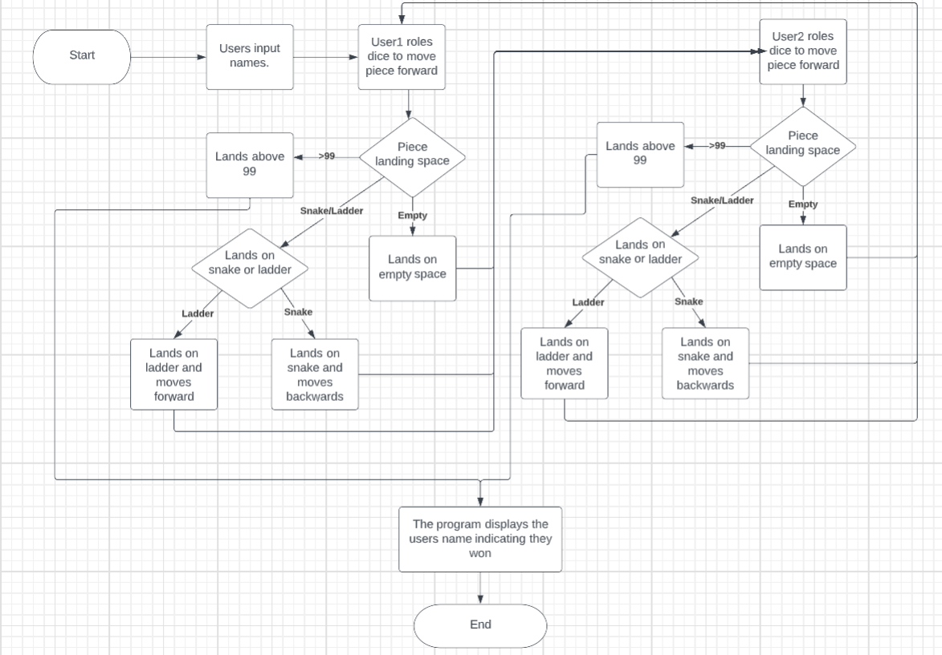
Flowchart
Notes:
This flowchart explains the main logic of the program. The users input their names then user1 would roll the dice.
Then the program goes through decision logic to determine weather the users piece landed on a snake, ladder, a normal space
or if they landed above 99 which means they won the game, in this scenario the program ends. In all the other scenarios the program
carries out the necessary processes depending on where the user landed and then user2 rolls the dice and the same decision logic and consequent processes repeat.
If again the game has not been won user1 rolls the dice; the program goes back and forth between the users in this manner until a winner is determined.

Slide 3
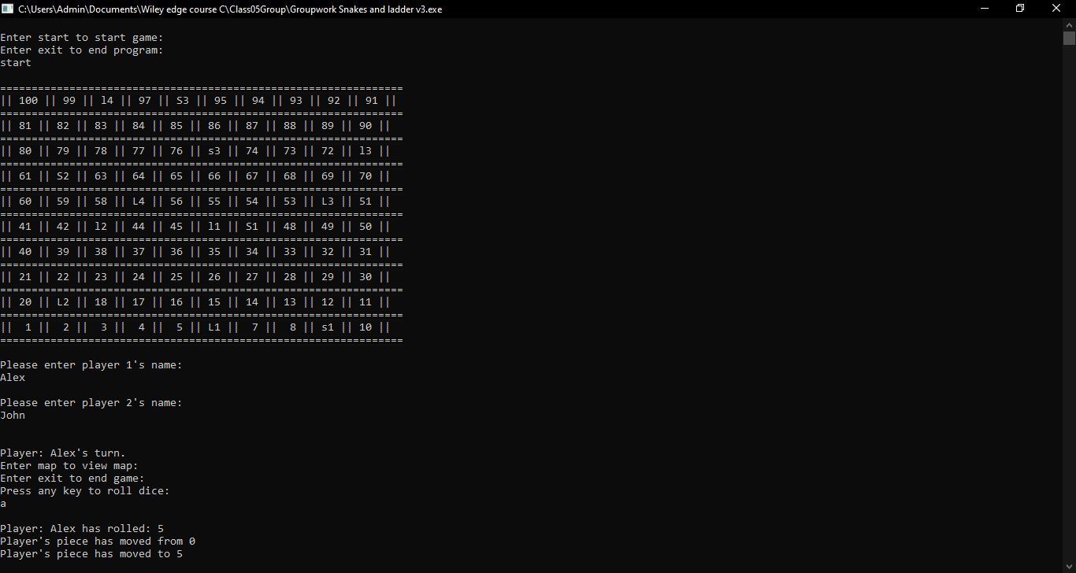
Program

Slide 4
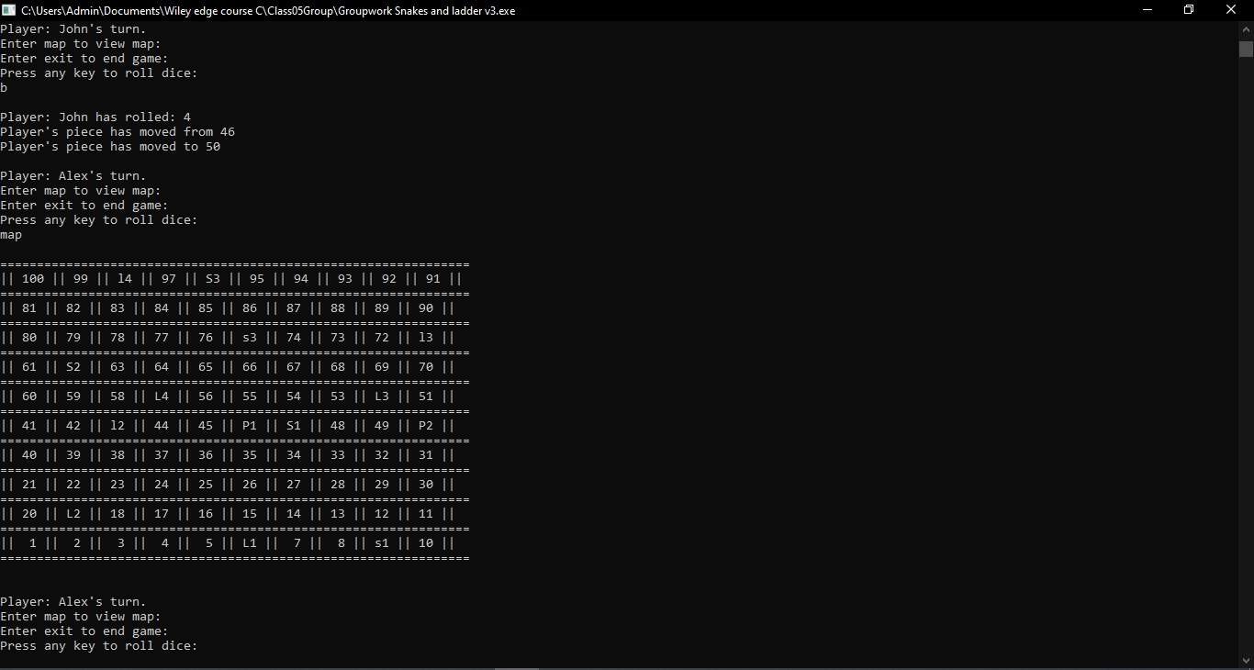
Program Map
Notes:
The user selects any button to roll the dice, Once the dice has been rolled the program informs the user what they rolled
and if they landed on any snakes or ladders further more it tells them what positions the snake/ladder takes them from and to,
finally the users new position is shown to the user. Before each roll the user has the option of typing 'map' to display the
current board, the different ladders are denoted by l1,l2,l3 and l4 with capitals (eg.L1) indicating where the ladder starts and
lowercase(e.g.. l1) indicating where the ladder takes you. The same semantics are applied for the snakes (s1,s2,s3...) with uppercase (e.g.. S1)
indicating the head of the snake and the lowercase (e.g.. s1) indicating what position the snake takes you down too (end of its tail).
Player position are denoted by 'P1' and 'P2' Respectively and in the scenario both player are on the same position the board will show 'PP' on that position

Slide 5
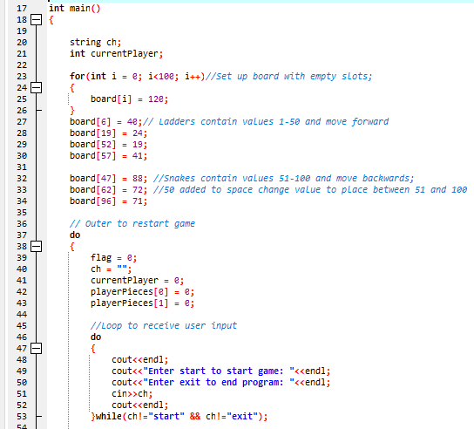
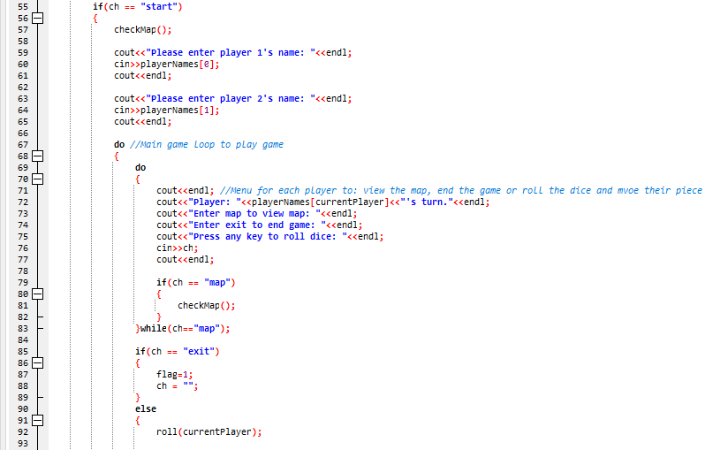
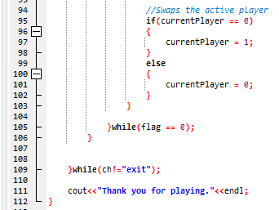
Main Loop

Slide 6
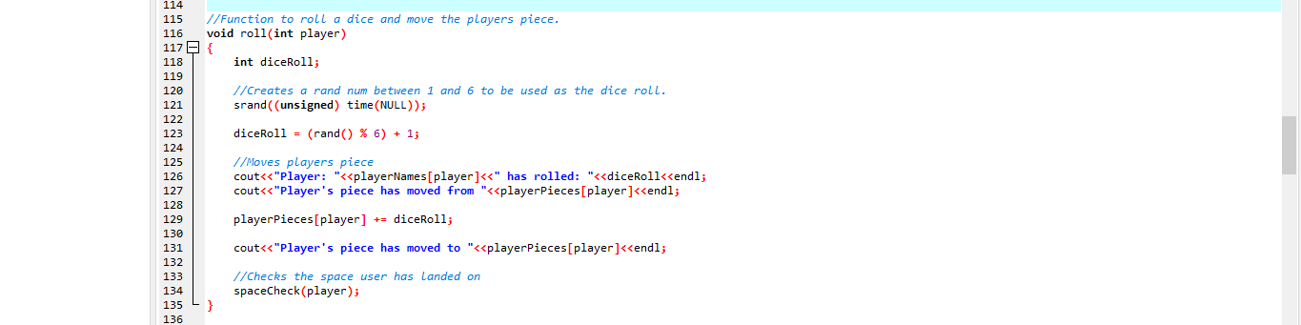
roll()

Slide 7
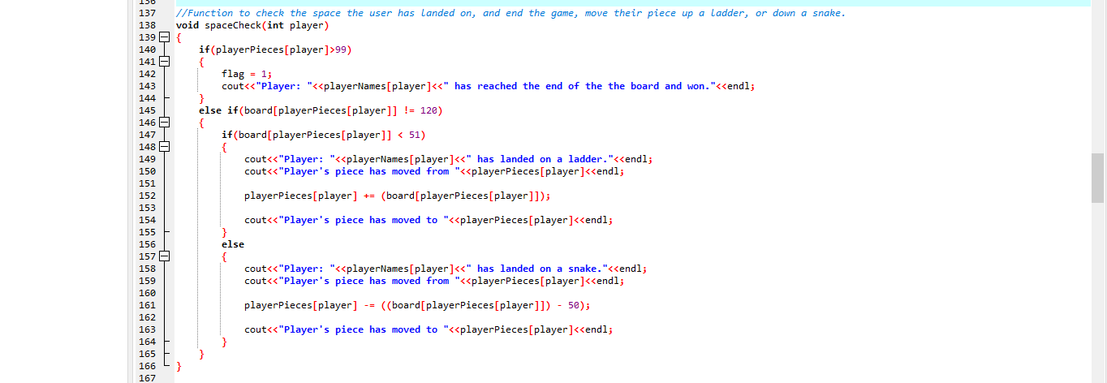
spaceCheck()

Slide 8
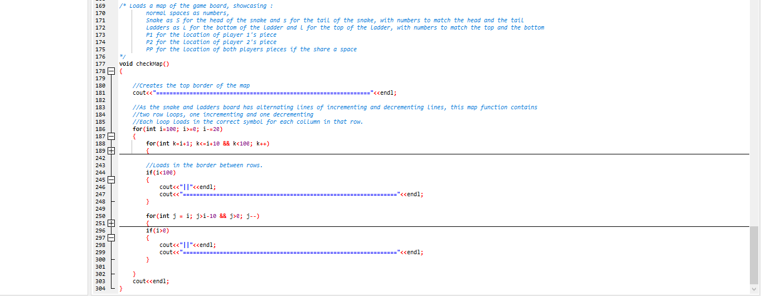
checkMap()

